Slide 1
Motivation and Basics
Il-Chul Moon Dept. of Industrial and Systems Engineering KAIST
icmoon@kaist.ac.kr

Slide 2
Weekly Objectives
Motivate the study on
Machine learning, AI, Datamining….
Why? What?
Overview of the field
Short questions and answers on a story
What consists of machine learning?
MLE
MAP
Some basics
Probability
Distribution
And some rules…

Slide 3
motivation

Slide 4

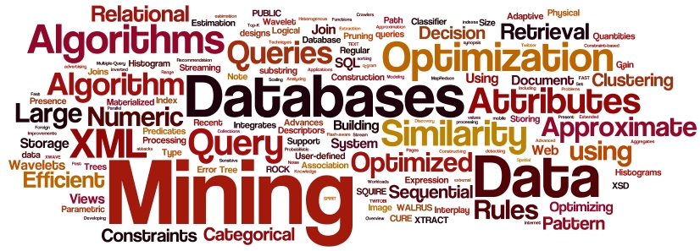
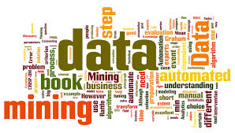


Keywords
Many floating keywords
Data-mining, Knowledge discovery, Machine Learning, Artificial Intelligence…
Comes from territory, perspectives, types of problems, researchers, etc
We are going to focus on substance, not labeling.
I am just going to call it “Machine Learning”
You can call it whatever you want
AI in CS
Statistics
Database in CS
Management
…….
Industrial Engineering

Slide 5
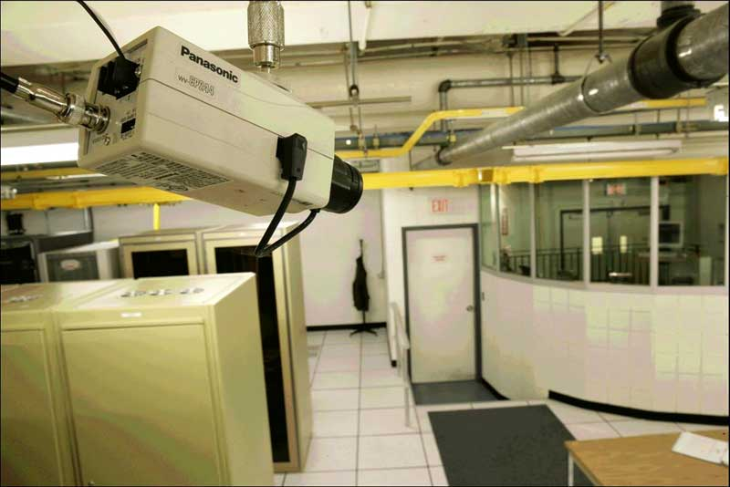
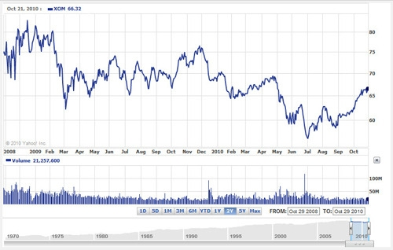
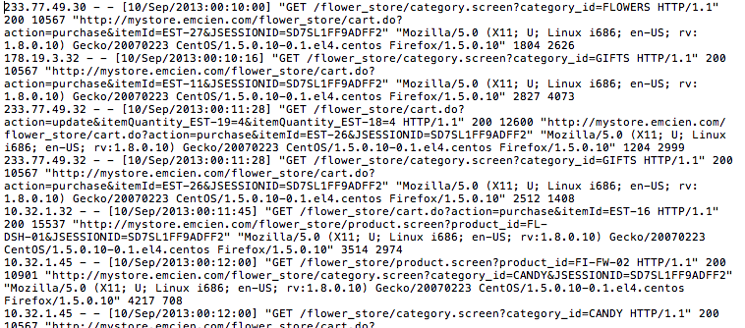




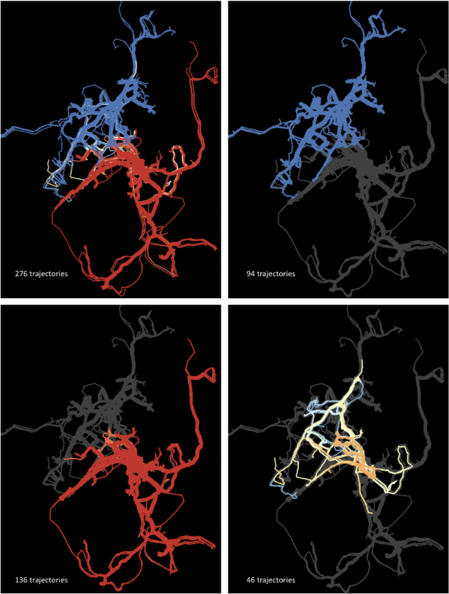
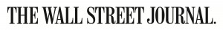
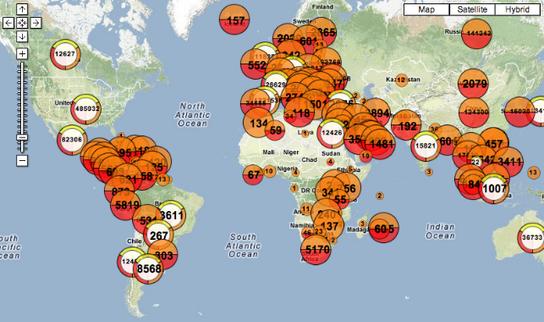
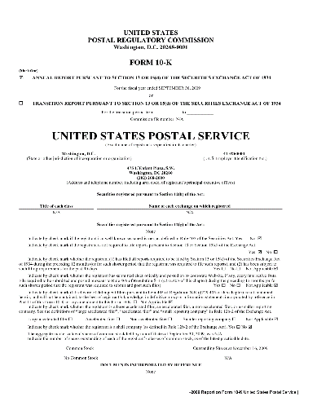


Abundance of Data
Image Data
Surveillance Data
Network Data
Data are being collected from everywhere
Text Data
Machine Logs
Social Networks
Trajectory Data
News Articles
Social Media
Disease Outbreak Data
10K Rep.
Purchase+Review Data
Time Series Data
Vehicle Trajectory Data

Slide 6
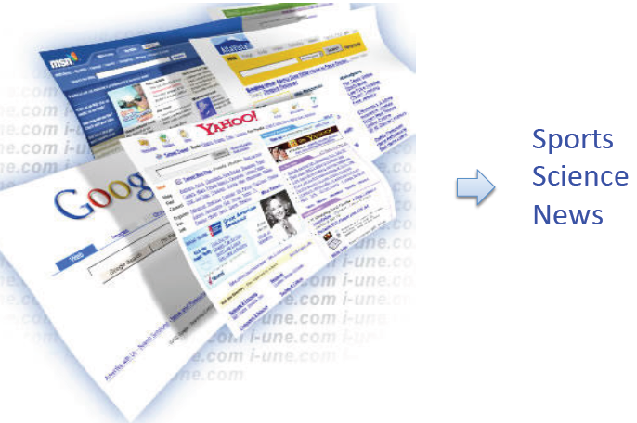
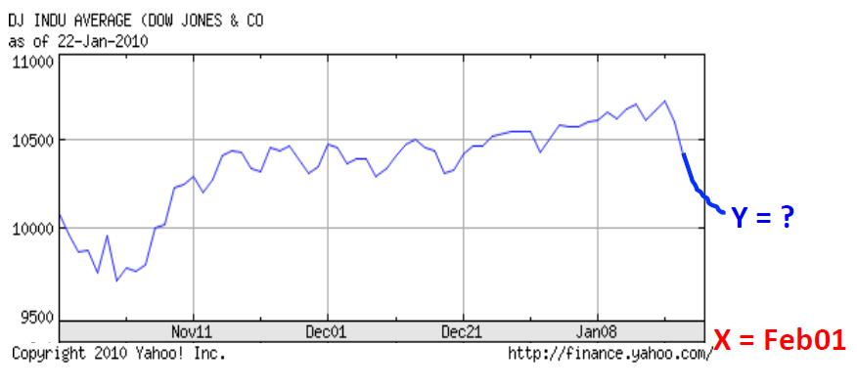
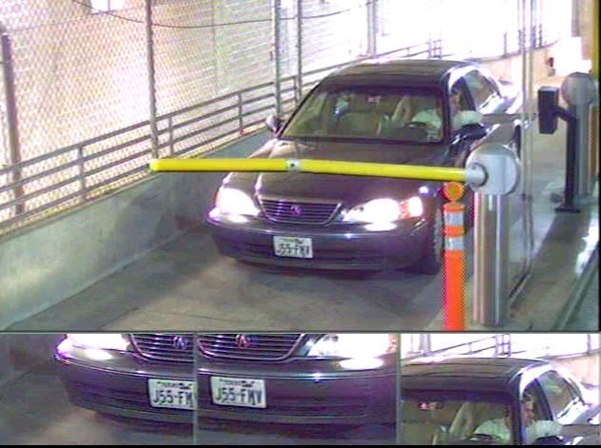
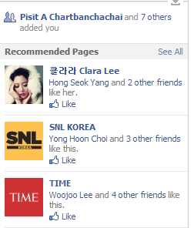
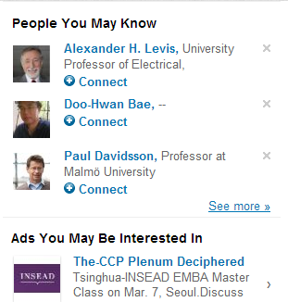
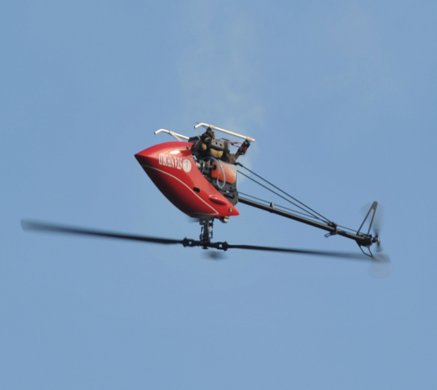
Examples of Machine Learning Applications
Machine Learning is everywhere…
Document Classification
Stock Market Prediction
Plate Num. Recognition
SNS Recommendation
Helicopter Control

Slide 7

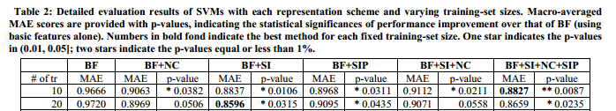
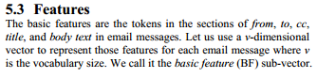
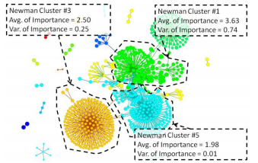
Spam Filtering and more
Importance
SVM?
Spam filter
More?
Importance vs. Urgency
How to predict an important email?
Social networks
Contents
Shinjae Yoo, Yiming Yang, Frank Lin, and Il-Chul Moon, Mining Social Networks for Personalized Email Prioritization, ACM SIGKDD Conference, Paris, France, Jun, 28, 2009
Features
Clusters?
Is this a machine learning technique?

Slide 8
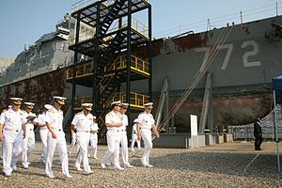
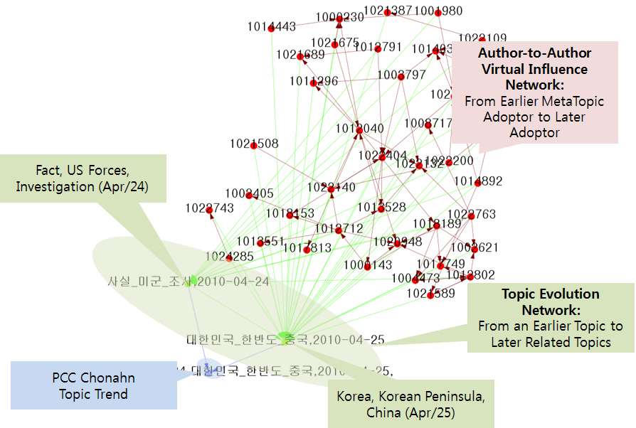

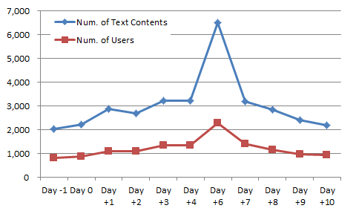
Opinion Mining and more
Il-Chul Moon, Alice H. Oh, and Kathleen M. Carley, Analyzing Social Media in Escalating Crisis Situations, IEEE Conference on Intelligence and Security Informatics (ISI 2011), pp. 71-76, Beijing, China, Jul 10-12, 2011
Finding out consensus of the population
- Mining population’s perception of the event
- Mining key opinion buried in a data chunk
- Estimating future polarity of the population
- Strategy to maintain the unity of the population
PCC Cheonan Sank on Mar 26, 2010
Data-mining on SNS and Texts
Observable System
Implicit System

Slide 9

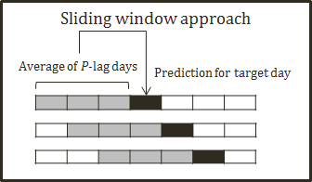

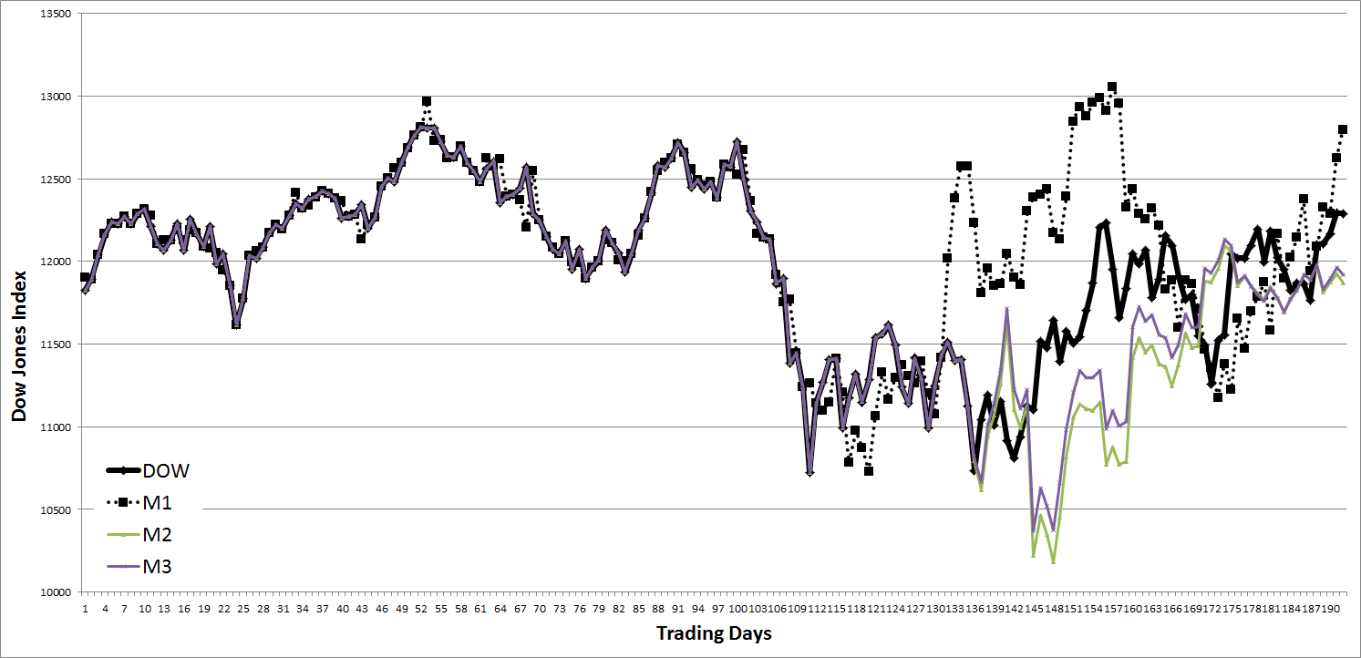
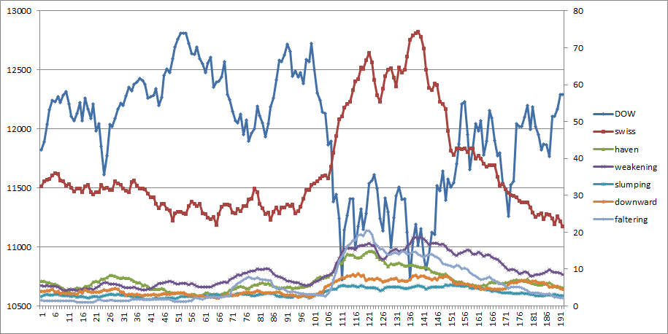
Stock Market Prediction and more
W.S. Lee, J.Y. Bak, A.H. Oh, and I.-C. Moon. Media Analysis to Estimate Stock Market
Movement. Information Fusion. Major Revision
Economic Indicators
High Coefficients on Prediction
Indicators
Independent variables
TopicWeight 26 | TopicWeight 1 | TopicWeight 7
-0.609 | 0.520 | 0.508
notes | obama | jun
moodys | republican | pence
swaps | republicans | na
treasuries | congress | swiss
versus | senate | chg
ratings | bill | francs
auction | barack | spa
default | lawmakers | fullyear
strategist | administration | nv
franc | democrats | dividend
twoyear | taxes | firstquarter
samp | white | ks
currencies | workers | paris
yen | democrat | reporting
swiss | obamas | tech
Bloomberg
Dealbreaker
Word
filtering & counting
Word count
Support
Vector
Regression
Latent Dirichlet Allocation
Topic weight
output
MAPE
Aspect Sentiment Unification Model
Senti-topic weight
Dependent variables
DOW
NASDAQ
-3 trading days
+1 day price
US Credit Downgrade
QE2
Europe Debt Crisis
Heavy negative correlation between “swiss” and DJIA

Slide 10
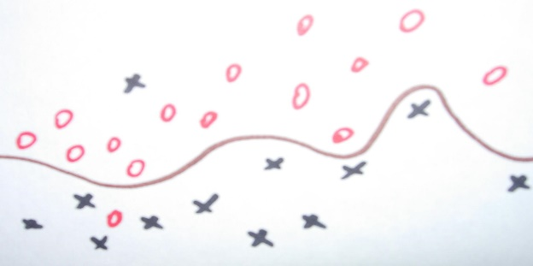
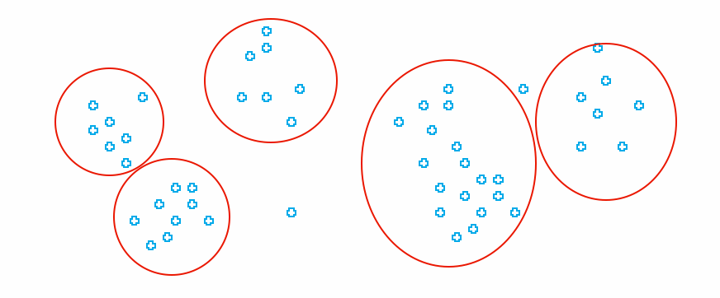
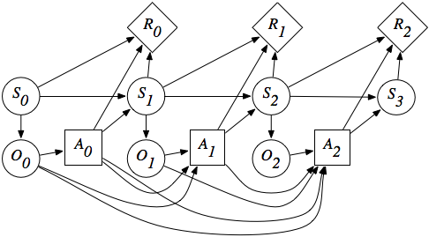
Types of Machine Learning
Machine Learning
…..
Supervised Learning
Unsupervised Learning
Reinforcement Learning
You know the true answers of some of instances
You do not know the true answers of instances
You do know the objective, but you do not know how to achieve
You can
Machine learning
Dataset provider
Machine learning users
etc
Various classifications by different professors
Purpose, data types, etc
Other learning classifications also exist

Slide 11
Supervised Learning
Supervised Learning
You know the true answers of some of instances
You know the true value, and you can provide examples of the true value.
Cases, such as
Spam filtering
Automatic grading
Automatic categorization
Classification or Regression of
Hit or Miss: Something has either disease or not.
Ranking: Someone received either A+, B, C, or F.
Types: An article is either positive or negative.
Value prediction: The price of this artifact is X.
Methodologies
Classification: estimating a discrete dependent value from observations
Regression: estimating a (continuous) dependent value from observations

Slide 12
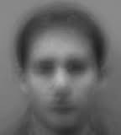
Unsupervised Learning
Unsupervised Learning
You do not know the true answers of instances
You don’t know the true value, and you cannot provide examples of the true value.
Cases, such as
Discovering clusters
Discovering latent factors
Discovering graph structures
Clustering or filtering or completing of
Finding the representative topic words from text data
Finding the latent image from facial data
Completing the incomplete matrix of product-review scores
Filtering the noise from the trajectory data
Methodologies
Clustering: estimating sets and affiliations of instances to the sets
Filtering: estimating underlying and fundamental signals from the mixture of signals and noises

Slide 13
Warming up A short episode

Slide 14
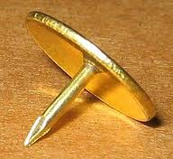
Thumbtack Question
There is a gambling site with a game of flipping a thumbtack
Nail is up, and you betted on nail’s up you get your money in double
Same to the nail’s down
A billionaire wants to enter the gambling
With scientific and engineering supports
He is paying you a big chunk of money
He asks you
I have a thumbtack, if I flip it, what’s the probability that it will fall with the nail’s up?
Your response?

Slide 15
Experience from trials
My response is
Please flip it a few times
Billionaire tried for five times
The nail’s up case is three out of five trials
My response is
You should invest
3/5 to nail’s up case
2/5 to nail’s down case
The billionaire asks why?
Then,
You answer……

Slide 16
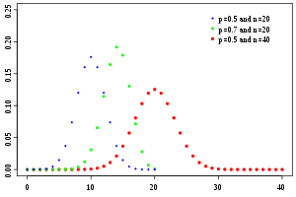
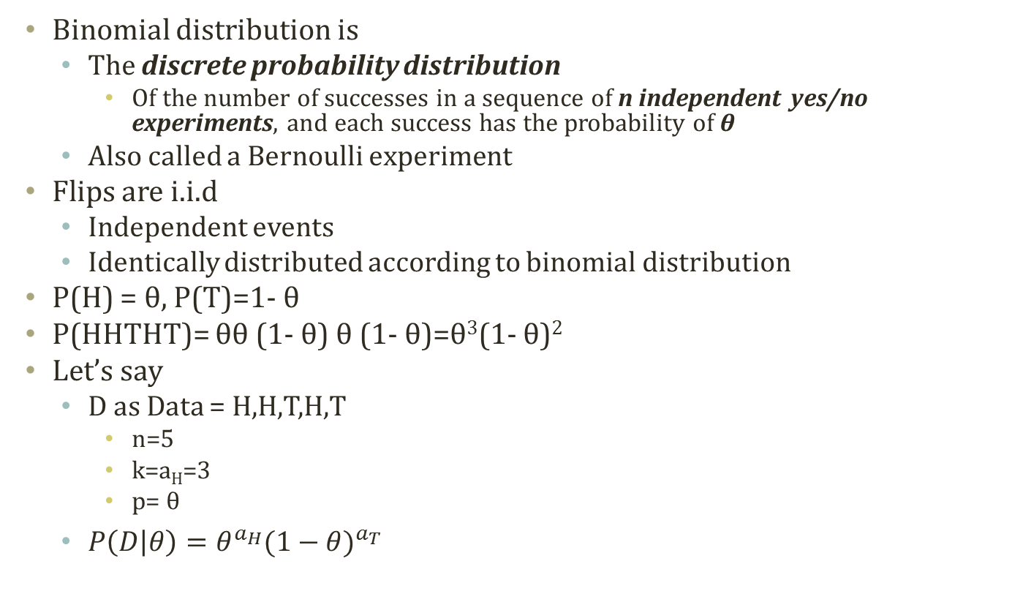
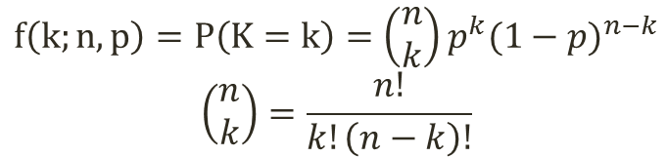
Binomial Distribution
Binomial distribution is
The discrete probability distribution
Of the number of successes in a sequence of n independent yes/no experiments, and each success has the probability of θ
Also called a Bernoulli experiment
Flips are i.i.d
Independent events
Identically distributed according to binomial distribution
P(H) = θ, P(T)=1- θ
P(HHTHT)= θθ (1- θ) θ (1- θ)=θ³(1- θ)²
Let’s say
D as Data = H,H,T,H,T
n=5
k=a_{H}=3
p= θ
$P\left(D | θ\right)=θ^{a_{H}}{(1−θ)}^{a_{T}}$
n and p are given as parameters, and the value is calculated by varying k
$$f\left(k;n,p\right)=P\left(K=k\right)=\left(\begin{aligned}n \\ k\end{aligned}\right)p^{k}{(1−p)}^{n−k}$$
$$\left(\begin{aligned}n \\ k\end{aligned}\right)=\frac{n!}{k!\left(n−k\right)!}$$
Makes order insensitive

Slide 17
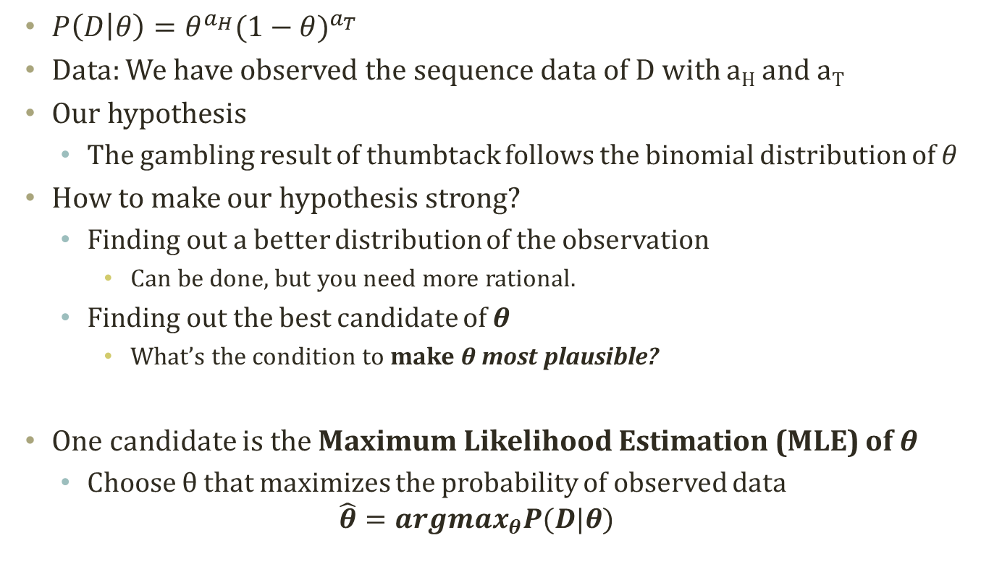
Maximum Likelihood Estimation
$P\left(D | θ\right)=θ^{a_{H}}{(1−θ)}^{a_{T}}$
Data: We have observed the sequence data of D with a_{H} and a_{T}
Our hypothesis
The gambling result of thumbtack follows the binomial distribution of $θ$
How to make our hypothesis strong?
Finding out a better distribution of the observation
Can be done, but you need more rational.
Finding out the best candidate of θ
What’s the condition to make θ most plausible?
One candidate is the Maximum Likelihood Estimation (MLE) of θ
Choose θ that maximizes the probability of observed data $\hat{θ}={argmax}_{θ}P(D|θ)$

Slide 18
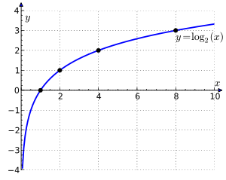
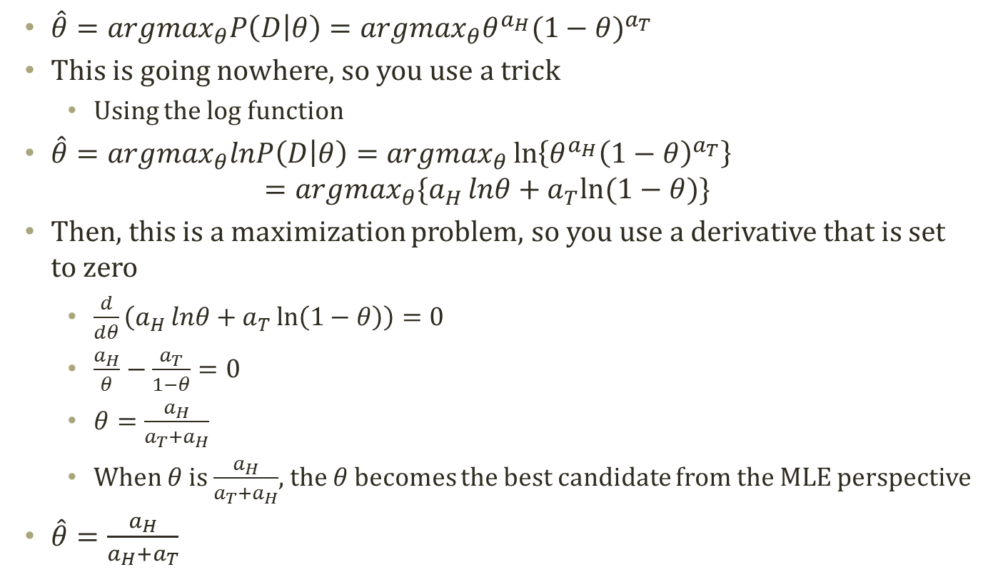
MLE Calculation
$\hat{θ}={argmax}_{θ}P\left(D | θ\right)={argmax}_{θ}θ^{a_{H}}{(1−θ)}^{a_{T}}$
This is going nowhere, so you use a trick
Using the log function
$\hat{θ}={argmax}_{θ}lnP\left(D | θ\right)={argmax}_{θ}\ln\left\{θ^{a_{H}}{\left(1−θ\right)}^{a_{T}}\right\}$
$$={argmax}_{θ}\{a_{H}{lnθ}+a_{T}ln⁡(1−θ)\}$$
Then, this is a maximization problem, so you use a derivative that is set to zero
$\frac{d}{dθ}\left(a_{H}{lnθ}+a_{T}\ln\left(1−θ\right)\right)=0$
$\frac{a_{H}}{θ}−\frac{a_{T}}{1−θ}=0$
$θ=\frac{a_{H}}{a_{T}+a_{H}}$
When $θ$ is $\frac{a_{H}}{a_{T}+a_{H}}$, the $θ$ becomes the best candidate from the MLE perspective
$\hat{θ}=\frac{a_{H}}{a_{H}+a_{T}}$

Slide 19
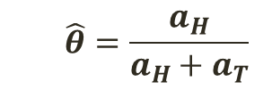
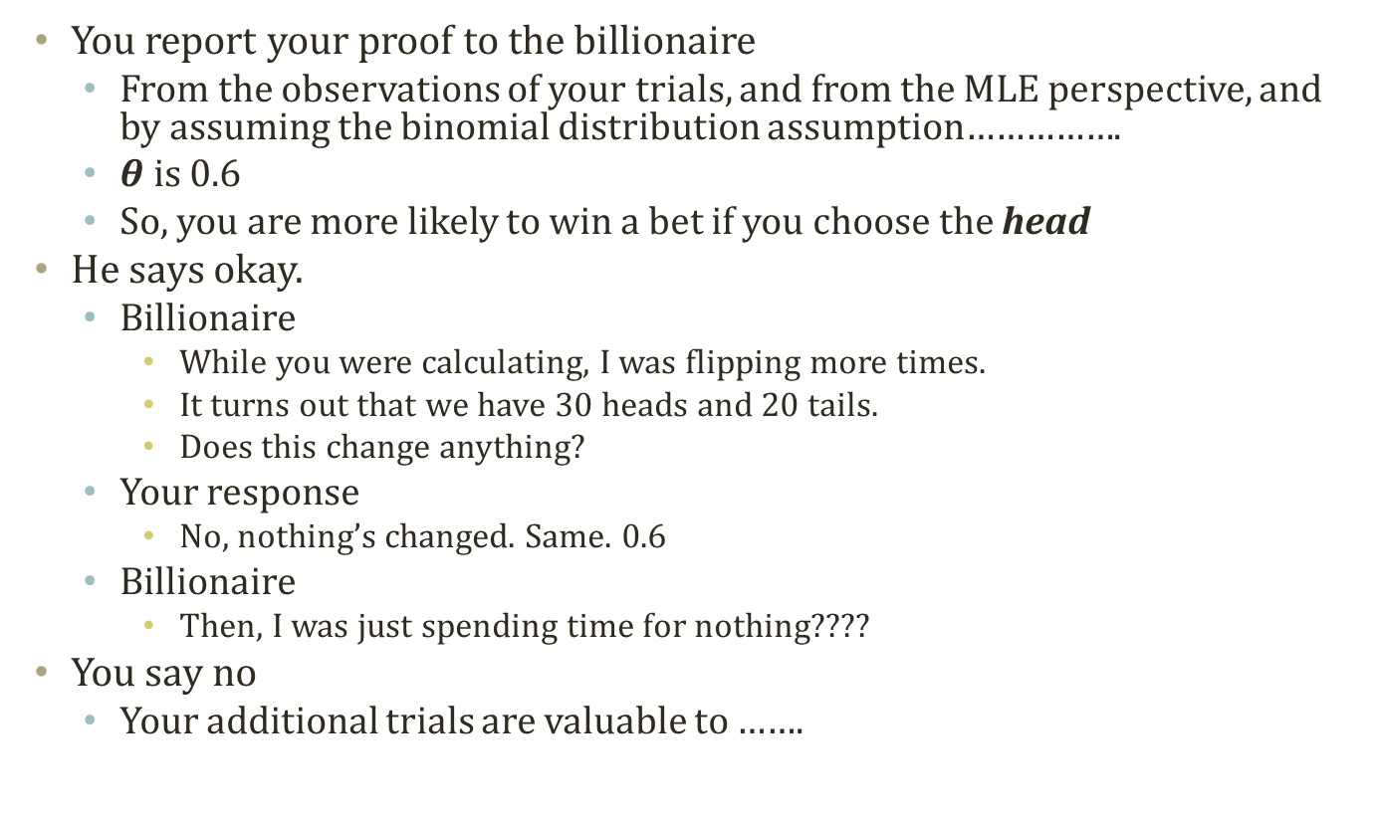
Number of Trials
$$\hat{θ}=\frac{a_{H}}{a_{H}+a_{T}}$$
You report your proof to the billionaire
From the observations of your trials, and from the MLE perspective, and by assuming the binomial distribution assumption…………….
$θ$ is 0.6
So, you are more likely to win a bet if you choose the head
He says okay.
Billionaire
While you were calculating, I was flipping more times.
It turns out that we have 30 heads and 20 tails.
Does this change anything?
Your response
No, nothing’s changed. Same. 0.6
Billionaire
Then, I was just spending time for nothing????
You say no
Your additional trials are valuable to …….

Slide 20
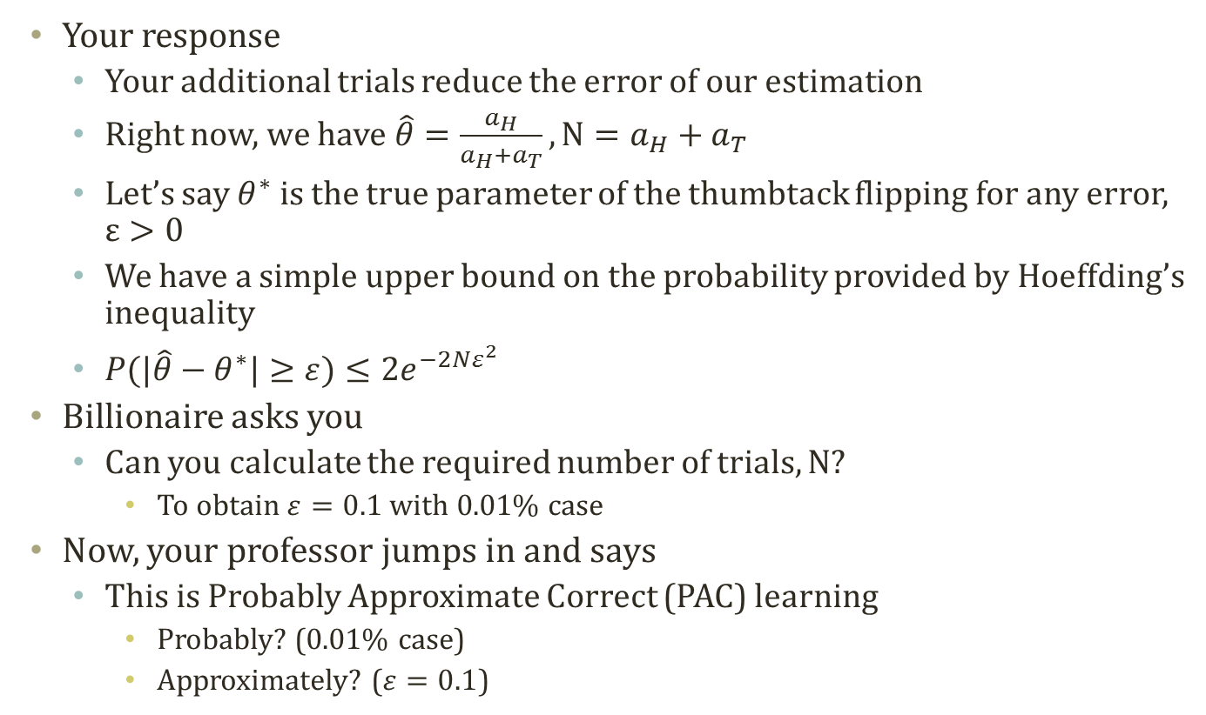
Simple Error Bound
Your response
Your additional trials reduce the error of our estimation
Right now, we have$\hat{θ}=\frac{a_{H}}{a_{H}+a_{T}}, N=a_{H}+a_{T}$
Let’s say $θ^{∗}$ is the true parameter of the thumbtack flipping for any error, $ε>0$
We have a simple upper bound on the probability provided by Hoeffding’s inequality
$P(|\hat{θ}−θ^{∗}|≥ε)≤{2e}^{−2Nε^{2}}$
Billionaire asks you
Can you calculate the required number of trials, N?
To obtain $ε=0.1$ with 0.01% case
Now, your professor jumps in and says
This is Probably Approximate Correct (PAC) learning
Probably? (0.01% case)
Approximately? ($ε=0.1$)
Coming from a friend in the math. dept.

Slide 21

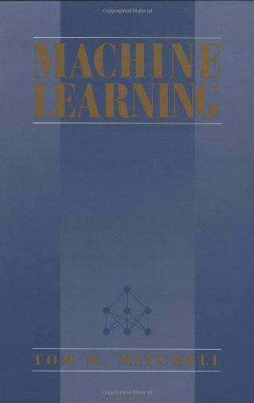
Probably Approximately Correct Learning
The PAC learning theory from the machine learning community,
The learner
Receives sample data
Select a generalization function, hypothesis
From a certain class of possible functions
Such that the selected function
Has low generalization error
With high probability
Definition of machine learning
Many views exist
Tom Mitchell
A computer program is said to
learn from experience E
With respect to some class of tasks T
And performance measure P, if its performance at tasks in T, as measured by P, improves with experience E
Is PAC Learning machine learning?
Old, but good book,
So called classic
Machine Learning
Given a dataset, we select a generalized function that provides most probable and most approximate answers

Slide 22
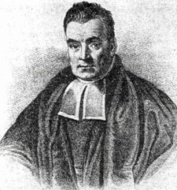
Wait!!!
A student whose name is Bayes raised his hand

Slide 23
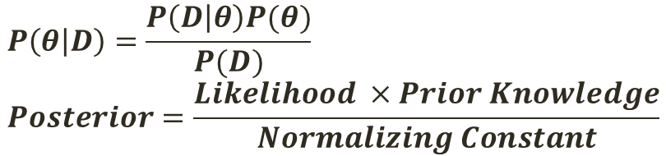
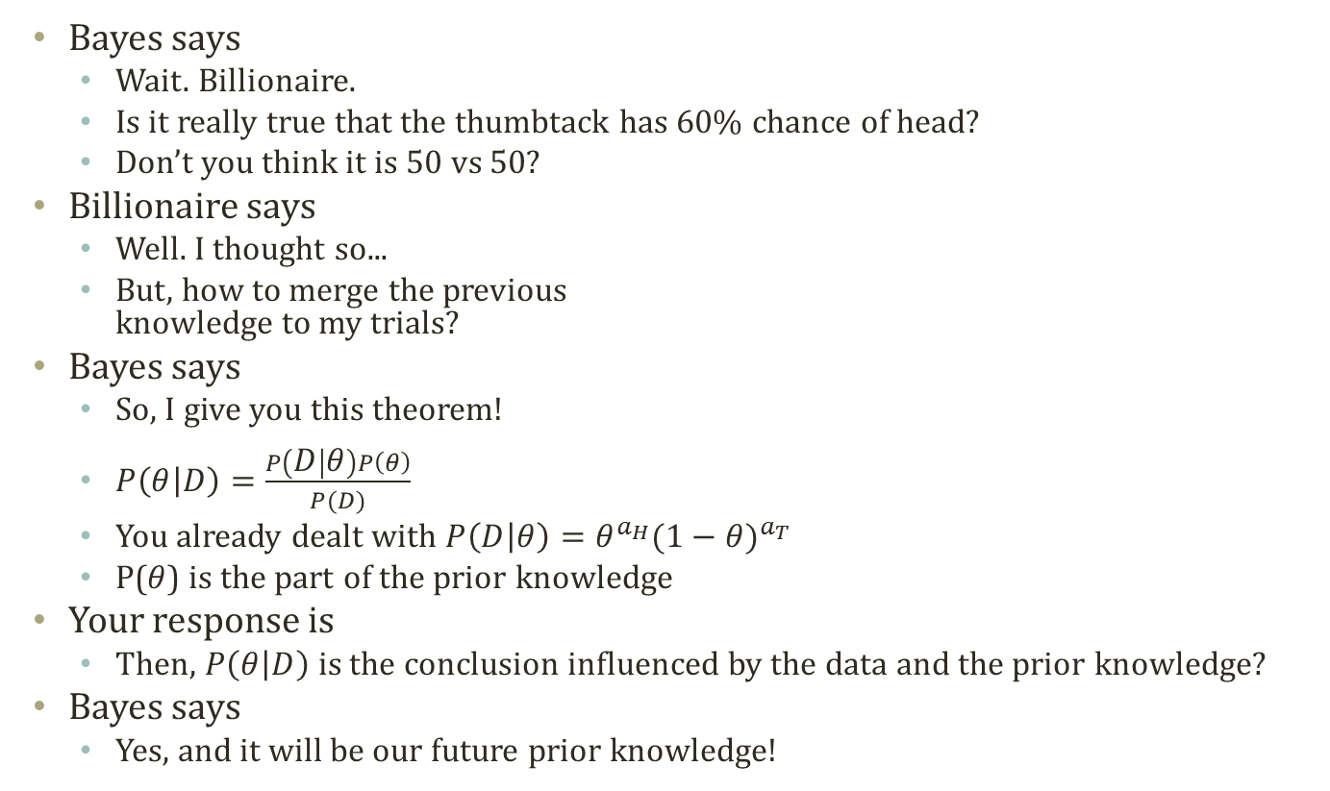
Incorporating Prior Knowledge
Bayes says
Wait. Billionaire.
Is it really true that the thumbtack has 60% chance of head?
Don’t you think it is 50 vs 50?
Billionaire says
Well. I thought so...
But, how to merge the previous knowledge to my trials?
Bayes says
So, I give you this theorem!
$P\left(θ | D\right)=\frac{P\left(D | θ\right)P\left(θ\right)}{P(D)}$
You already dealt with $P\left(D | θ\right)=θ^{a_{H}}{(1−θ)}^{a_{T}}$
P($θ$) is the part of the prior knowledge
Your response is
Then, $P\left(θ | D\right)$ is the conclusion influenced by the data and the prior knowledge?
Bayes says
Yes, and it will be our future prior knowledge!
$$P\left(θ | D\right)=\frac{P\left(D | θ\right)P(θ)}{P(D)} \\ Posterior=\frac{Likelihood ×Prior Knowledge}{Normalizing Constant}$$

Slide 24
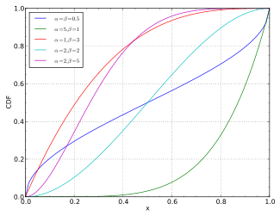
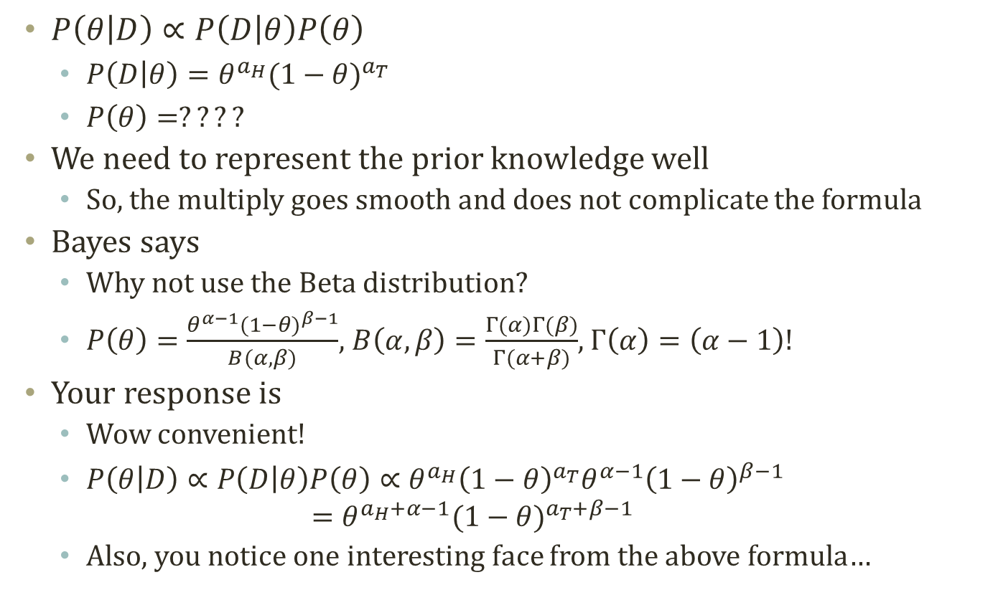
More Formula from Bayes Viewpoint
$P\left(θ | D\right)∝P\left(D | θ\right)P\left(θ\right)$
$P\left(D | θ\right)=θ^{a_{H}}{(1−θ)}^{a_{T}}$
$P\left(θ\right)=????$
We need to represent the prior knowledge well
So, the multiply goes smooth and does not complicate the formula
Bayes says
Why not use the Beta distribution?
$P\left(θ\right)=\frac{θ^{α−1}{(1−θ)}^{β−1}}{B(α,β)}$, $B\left(α,β\right)=\frac{Γ(α)Γ(β)}{Γ(α+β)}$, $Γ\left(α\right)=\left(α−1\right)!$
Your response is
Wow convenient!
$P\left(θ | D\right)∝P\left(D | θ\right)P\left(θ\right)∝θ^{a_{H}}{\left(1−θ\right)}^{a_{T}}θ^{α−1}{\left(1−θ\right)}^{β−1}$
$$=θ^{a_{H}+α−1}{(1−θ)}^{a_{T}+β−1}$$
Also, you notice one interesting face from the above formula…
Nice match to the range!

Slide 25
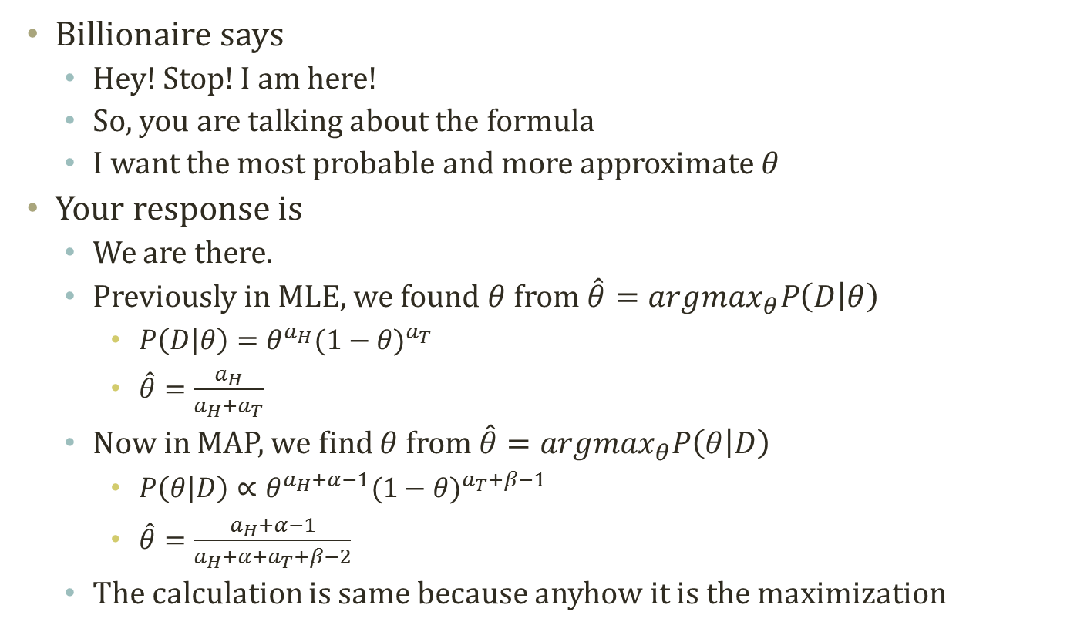
Maximum a Posteriori Estimation
Billionaire says
Hey! Stop! I am here!
So, you are talking about the formula
I want the most probable and more approximate $θ$
Your response is
We are there.
Previously in MLE, we found $θ$ from $\hat{θ}={argmax}_{θ}P\left(D | θ\right)$
$P\left(D | θ\right)=θ^{a_{H}}{(1−θ)}^{a_{T}}$
$\hat{θ}=\frac{a_{H}}{a_{H}+a_{T}}$
Now in MAP, we find $θ$ from $\hat{θ}={argmax}_{θ}P\left(θ | D\right)$
$P\left(θ | D\right)∝θ^{a_{H}+α−1}{(1−θ)}^{a_{T}+β−1}$
$\hat{θ}=\frac{a_{H}+α−1}{a_{H}+α+a_{T}+β−2}$
The calculation is same because anyhow it is the maximization

Slide 26
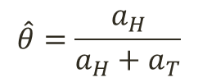
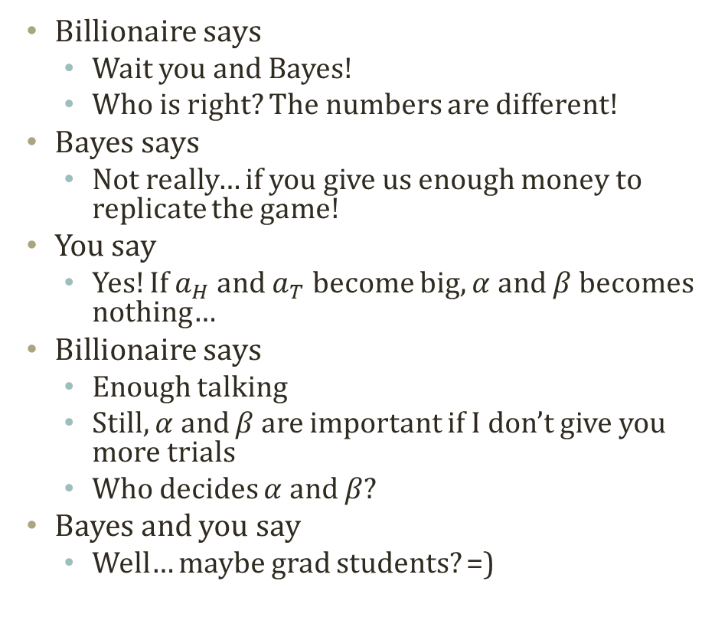
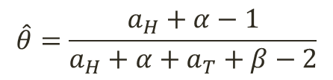
Conclusion from Anecdote
Billionaire says
Wait you and Bayes!
Who is right? The numbers are different!
Bayes says
Not really… if you give us enough money to replicate the game!
You say
Yes! If $a_{H}$ and $a_{T}$ become big, $α$ and $β$ becomes nothing…
Billionaire says
Enough talking
Still, $α$ and $β$ are important if I don’t give you more trials
Who decides $α$ and $β$?
Bayes and you say
Well… maybe grad students? =)
MLE
$$\hat{θ}=\frac{a_{H}}{a_{H}+a_{T}}$$
MAP
$$\hat{θ}=\frac{a_{H}+α−1}{a_{H}+α+a_{T}+β−2}$$

Slide 27
basics

Slide 28
What we just saw is…
Bayes says
Why not use the Beta distribution?
← From the knowledge of probability, distribution, and statistics
A struggle
Billionaire
To earn money by analyzing a small dataset out of huge possibilities
You
To give the billionaire the best probable and approximate answers from the small dataset
Bayes
To convince you that the prior knowledge can be incorporated to the answers
Eventually
Trying to find out the nature of the thumbtack game
The key is the probability of the thumbtack outcome, either head or tail
Underlying knowledge to solve the problem
Probability
Distribution
Some mathematical tricks
To go further, you need to know these

Slide 29
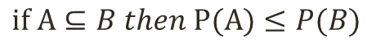
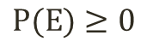








Probability
$$Ω$$
E₂
E₁
Philosophically, Either of the two
Objectivists assign numbers to describe states of events, i.e. counting
Subjectivists assign numbers by your own belief to events, i.e. betting
Mathematically
A function with the below characteristics
Subsequent characteristics
$$P(E)∈R$$
$$P(E)≥0$$
$$∀E∈F$$
$$P\left(Ω\right)=1$$
$$P\left(E_{1}∪E_{2}∪…\right)=\sum_{i=1}^{∞}{P\left(E_{i}\right)} when a sequence of mutually exclusive$$
$$if A⊆B then P(A)≤P(B)$$
$$P\left(∅\right)=0$$
$$0≤P\left(E\right)≤1$$
$$P\left(A∪B\right)=P\left(A\right)+P\left(B\right)−P(A∩B)$$
$$P\left(E^{C}\right)=1−P\left(E\right)$$

Slide 30






Conditional Probability
$$Ω$$
Scope
$≈$Condition
E₁
E₂
We often do not handle the universe, $Ω$
Somehow, we always make conditions
Assuming that the parameters are X, Y, Z,…..
Assuming that the events in the scope of X, Y, Z,….
$P\left(A | B\right)=\frac{P(A∩B)}{P(B)}$
The conditional probability of A given B
Some handy formula
$$Posterior=\frac{Likelihood ×Prior Knowledge}{Normalizing Constant}$$
$$P\left(B | A\right)=\frac{P\left(A | B\right)P(B)}{P(A)}$$
$$P(A)=\sum_{n}{P(A|B_{n})P(B_{n})}$$
Nice to see that we can switch the condition and the target event
Nice to see that we can recover the target event by adding the whole conditional probs and priors

Slide 31





Probability Distribution
Probability distribution assigns
A probability to a subset of the potential events of a random trial, experiment, survey, etc.
A function mapping an event to a probability
Because we call it a probability, the probability should keep its own characteristics (or axioms)
An event can be
A continuous numeric value from surveys, trials, experiments…
A discrete categorical value from surveys, trials, experiments…
For example,
$$f\left(x\right)=\frac{e^{−\frac{1}{2}x^{2}}}{\sqrt{2π}}$$
f: a probability distribution function
x: a continuous value
f(x): assigned probs
Probability Density Function (PDF)=$f(x)$
Cumulative Distribution Function (CDF) =$\int_{−∞}^{x}{f(x)}dx$

Slide 32

Normal Distribution
Very commonly observed distribution
Continuous numerical value
$f\left(x;μ,σ\right)=\frac{1}{σ\sqrt{2π}}e^{−\frac{{(x−μ)}^{2}}{2σ^{2}}}$
Notation: $N(μ, σ^{2})$
Mean: $μ$
Variance: $σ^{2}$

Slide 33


Beta Distribution
Supports a closed interval
Continuous numerical value
[0,1]
Very nice characteristic
Why?
Matches up the characteristics of probs
$f\left(θ;α,β\right)=\frac{θ^{α−1}{(1−θ)}^{β−1}}{B(α,β)}\text{, }B\left(α,β\right)=\frac{Γ(α)Γ(β)}{Γ(α+β)}\text{, }$ $Γ\left(α\right)=\left(α−1\right)!$
Notation: $Beta(α,β)$
Mean: $\frac{α}{α+β}$
Variance: $\frac{αβ}{{\left(α+β\right)}^{2}(α+β+1)}$

Slide 34



Binomial Distribution
Simplest distribution for discrete values
Bernoulli trial, yes or no
0 or 1
Selection, switch….
$f\left(θ;n,p\right)=\left(\begin{aligned}n \\ k\end{aligned}\right)p^{k}{(1−p)}^{n−k}, \left(\begin{aligned}n \\ k\end{aligned}\right)=\frac{n!}{k!\left(n−k\right)!}$
Notation: $B(n,p)$
Mean: $np$
Variance: $np(1−p)$

Slide 35

Multinomial Distribution
The generalization of the binomial distribution
Beyond yes/no
Choose A, B, C, D, E,….,Z
Word selection, cluster selection…..
$f\left(x_{1},…,x_{k};n,p_{1},…,p_{k}\right)=\frac{n!}{x_{1}!…x_{k}!}{p_{1}}^{x_{1}}…{p_{k}}^{x_{k}}$
Notation: $Mult\left(P\right), P=<p_{1},…,p_{k}$>
Mean: $E\left(x_{i}\right)=np_{i}$
Variance: $Var\left(x_{i}\right)=np_{i}(1−p_{i}$)

Slide 36
Acknowledgement
This slideset is greatly influenced
By Prof. Carlos Guestrin at CMU
By Prof. Eric P. Xing at CMU
Some images are copied from the lecture slides made
By Prof. Carlos Guestrin at CMU
By Prof. Eric P. Xing at CMU

Slide 37
Further Readings
Bishop Chapter 1 and 2

